Slide 1
LOGISTIC REGRESSION

Slide 2

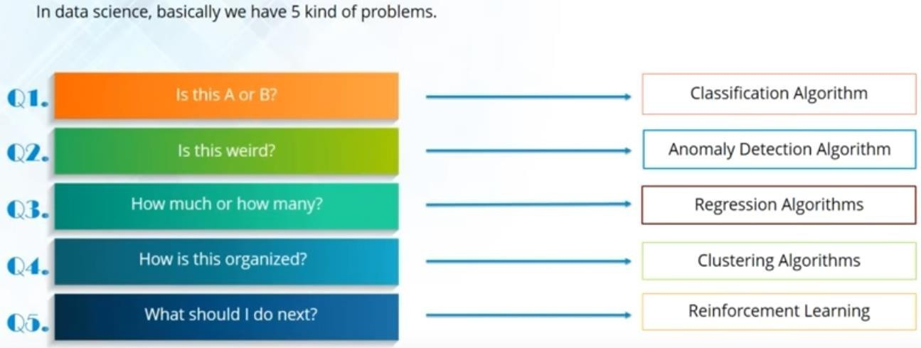
Algorithms to solve Business Problems

Slide 3

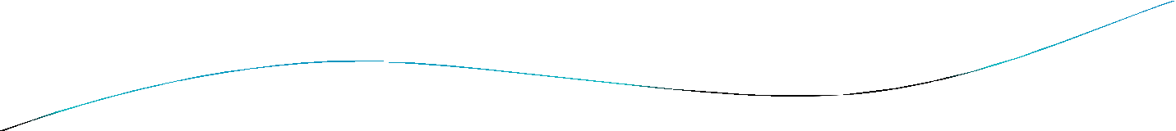



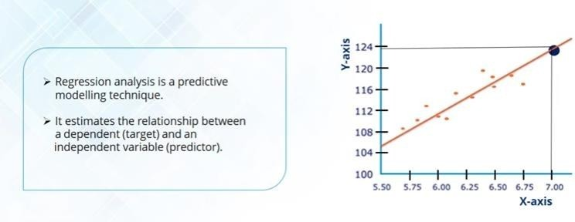
What is Regression?
In statistical modeling, regression analysis is a statistical process for estimating the relationships among variables. It includes many techniques for modeling and analyzing several variables, when the focus is on the relationship between a dependent variable and one or more independent variables (or 'predictors').
Correlation and Regression are not the same. Correlation quantifies the degree to which two variables are related. Correlation does not fit a line through the data points. Simply You are computing a correlation coefficient
(r) that tells you how much one variable tends to change when the other one does.

Slide 4


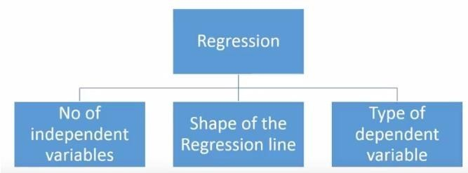
Type of Regression
Linear Regression : Dependent variable is continuous, independent variable(s) can be continuous or discrete, and nature of regression line is linear.
Logistic Regression: Dependent variable is binary (0/ 1, True/ False, Yes/ No)
Polynomial Regression: A regression equation is a polynomial regression equation if the power of independent variable is more than 1, the best fit line is not a straight line. It is rather a curve that fits into the data points.
Stepwise Regression: when we deal with multiple independent variables. In this technique, the selection of independent variables is done with the help of an automatic process, which involves no human intervention.
Ridge Regression: Ridge Regression is a technique used when the data suffers from multicollinearity
( independent variables are highly correlated). In multicollinearity, even though the least squares estimates (OLS) are unbiased, their variances are large which deviates the observed value far from the true value.
Lasso Regression: Similar to Ridge Regression, Lasso (Least Absolute Shrinkage and Selection Operator)
also penalizes the absolute size of the regression coefficients. In addition, it is capable of reducing the variability and improving the accuracy of linear regression models.
7. ElasticNet Regression: ElasticNet is hybrid of Lasso and Ridge Regression techniques. It is trained with L1 and L2 prior as regularizer. Elastic-net is useful when there are multiple features which are correlated.
4

Slide 5


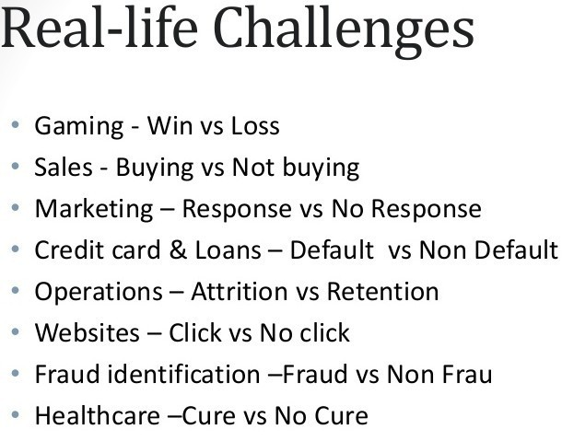
Logit Use
cases

Slide 6



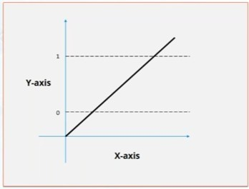
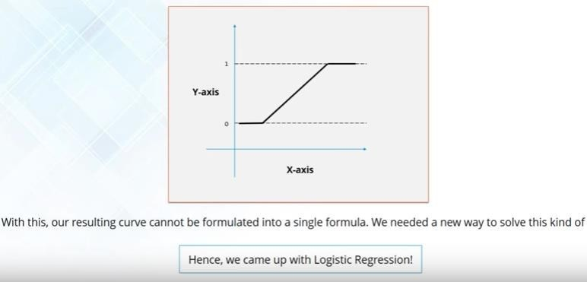
Why Logistic
Regression/Logit
Whenever the outcome of the Dependent variable is discrete, like 0/ 1, True/ False, Yes/ No, A, B, C
The model guarantees the probability of an observation belonging to a particular group is 0 or 1.
No matter how hard we try, OLS regression probability will be outside 0-1 range in all likelihood.

Slide 7


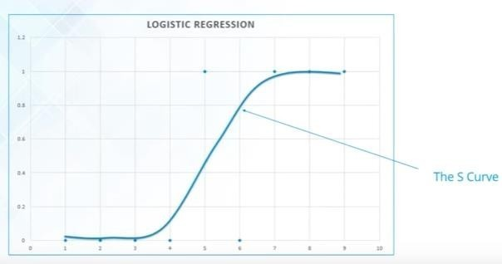
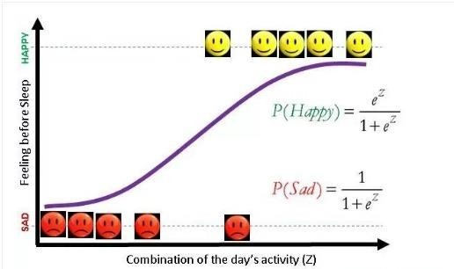
Some concepts
•
Binary logit model commonly deals
with the issue of classifying an
observation into one of two groups. In this sense it is similar to two group discriminant analysis.
•
•
Sigmoid Curve also known as S Curve.
Odds are used to counteract the fact that linear regression produces probability outside the range of 0 and 1. Going with Odds forces the upper bound on the probability. Lower bound is achieved by taking natural Log of regression value.

Slide 8
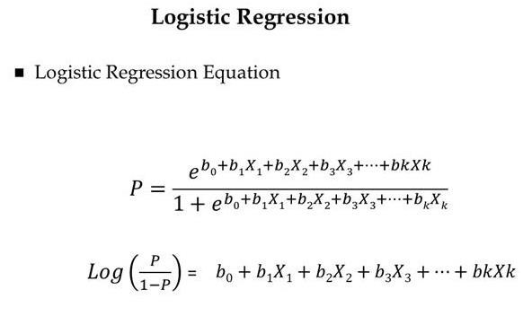
•
One way to conceptualize (non-technically) the probability of an event is the number of ways that an event can occur divided by the total number of possible outcomes.
The odds for an event is the ratio of the number of ways the event can occur to the number of ways it does not occur.
An odds ratio (OR) is a measure of association between an exposure and an outcome. The OR represents the odds that an outcome will occur given a particular exposure, compared to the odds of the outcome occurring in the absence of that exposure.
Logit is successful due to Odds Ratio.
When a logistic regression is calculated, the regression coefficient (b1) is the estimated increase in the log odds of the outcome per unit increase in the value of the exposure.
The 95% confidence interval (CI) is used to estimate the precision of the OR. Maximum Likelihood Estimation decides the slopes/individual coefficients.
Logit and Probit forms the Bell curve.
•
•
•
•
•
•

Slide 9


Steps involved in Logistic Regression
Log Likelihood Ratio Test : A statistical test used for comparing the goodness of fit of two models, one of which (the null model) is a special case of the other (the alternative model).
Pseudo R Square: Indicates the Model robustness, R2 reduces the uncertainty produced by the intercept model.
Individual Coefficients: Indicates the statistical importance of the predictor variables.
Odds – EXP: Practical Importance of the predictor variables.
Predictor variable Importance: Methods to know the Predictor variables importance.
Confusion/Classification Matrix/Table: A confusion matrix is a table that is often used to describe the performance of a classification model (or "classifier") on a set of test data for which the true values are known.
ROC Plot: A receiver operating characteristic curve, i.e. ROC curve, is a graphical plot that illustrates the diagnostic ability of a binary classifier system as its discrimination threshold is varied.
Adjusting the Cutoff threshold values.

Slide 10


Case Study : Diabetes Dataset
Here is an interesting Diabetes Dataset, In particular, all patients here are females at least 21 years old of Pima Indian heritage.
Attribute Information:
Number of times pregnant
Plasma glucose concentration a 2 hours in an oral glucose tolerance test
Diastolic blood pressure (mm Hg)
Triceps skin fold thickness (mm)
2-Hour serum insulin (mu U/ml)
Body mass index (weight in kg/(height in m)^2)
Diabetes pedigree function
Age (years)
Class variable (0 or 1)
Exercise
•
•
•
Split the datasets into Training and Test (70:30). Develop a logistic regression model, obtain the output. Interpret the results and predict Diabetes occurrence.
1
0

Slide 11

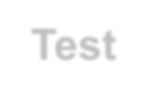
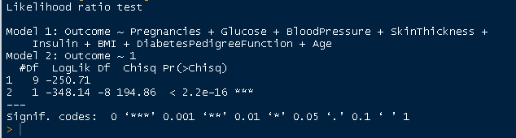
Log Likelihood Ratio Test
Interpretation
The overall test of model significance based on the ChiSq test above is indicating the likelihood of outcome depends on predictor variables.
Using the statistical Language this implies that the null hypothesis is of all Betas are Zero
is rejected and we conclude that at least one Beta is on zero.

Slide 12


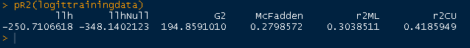
Pseudo R Square
Interpretation
Based on McFaden R Square, we conclude that 27.98 percent of the uncertainity of the
Intercept only Model (Model2) has been explained by the Full model (Model 1).
Thus the goodness of fit is reasonably robust.

Slide 13


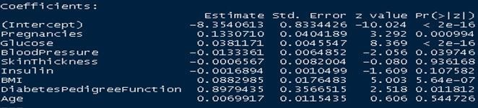
Individual Coefficients
Interpretation
Only Attitude towards Glucose/Pregnancies is significant in explaining Outcome.
Does this imply that focus should be on fostering more positive attitude on Glucose levels
and not worry too much about the Skin thickness/Insulin??
Yes as per statistical significance however No as per practical
significance (ODDS)

Slide 14



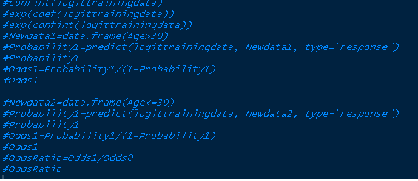
ODDS – EXP
 | Statisticall y | ODDS RATIO
 | Significant | >1
Basket1 | 1 | 1
Basket2 | 0 | 1
Basket3 | 1 | 0
Basket4 | 0 | 0
Interpretation
Basket 1 : Statistically significant and Odds is more than 1.
Basket 2 : Statistically NOT significant and Odds is more than 1
Basket 3 : Statistically significant and Odds less than 1
Basket 4 : Statistically NOT significant and Odds also less than 1

Slide 15


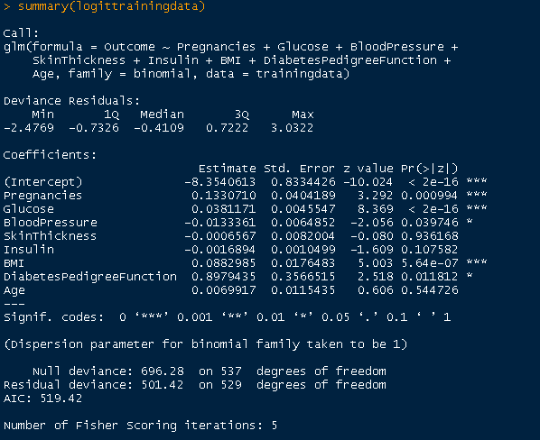
Predictor variable Importance

Slide 16


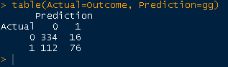
Classification Table
Interpretation
410 out of 538 observations are correctly classified indicating overall accuracy of
76.2 percent.
Also out of 350 No diabetic cases, model has correctly predicted 334 cases and gone wrong in 16 cases.
Likewise, out of 188 Diabetic cases, model correctly predicted 76 cases and gone wrong in 112 cases.
There is an issues between Type1 (Sensitivity) and Type2 (1-
specificity) errors.

Slide 17


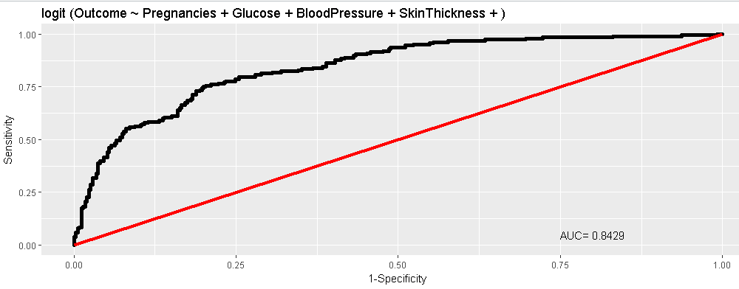
ROC Plot
Interpretation
Usually curve should not be near to the fit line.
AUC > 70% is reasonably good.

Slide 18

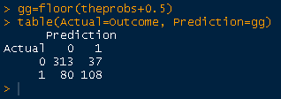
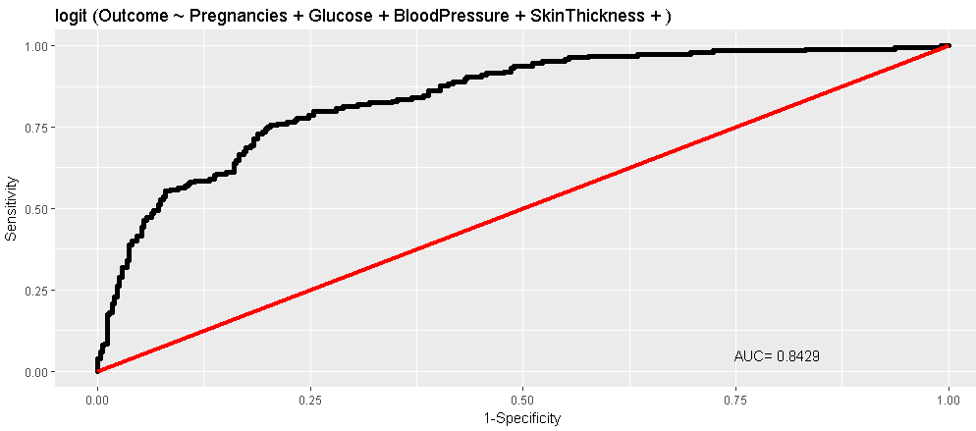
Adjusting the Cutoff/Threshold values

Slide 19

Rcodes
•
•
•
# Set the working Directory #setwd("D:/DataSscience/10_wipro/Talks/LogisticRegression") setwd("F:/0_1_Trainings/Wipro")
•
•
# Import the Data Set diabetesdata=read.csv("diabetes.csv", header=TRUE)
•
•
•
•
•
•
•
# Split the Data set into Training and Test in 70:30 proportion
# First run the model on Traininf Data and then validate it with Test data. library(caret)
set.seed(123)
index <- createDataPartition(diabetesdata$Outcome, p=0.70, list=FALSE) trainingdata <- diabetesdata[ index,]
testdata <- diabetesdata[-index,]
•
•
•
# List the Dimensions dim(trainingdata) dim(testdata)
•
•
•
•
### Predict and check on the Training Data attach(trainingdata)
#Model Fitting logittrainingdata=glm(Outcome~Pregnancies+Glucose+BloodPressure+SkinThicknes s+Insulin+BMI
+DiabetesPedigreeFunction+Age, data=trainingdata, family=binomial) #logittrainingdata=glm(Outcome~., data=trainingdata, family=binomial) #logittrainingdata=glm(Outcome~.-SkinThickness, data=trainingdata,
•
•
family=binomial)

Slide 20


#************************************c***o*Sdteep 1sLog Likelihood Ratio Test
R
•
****************************************#
library(lmtest)
lrtest(logittrainingdata)
#****************************************Step 2 Pseudo R Square
*************************************************#
library(pscl) pR2(logittrainingdata)
#****************************************Step 3 Individual Coefficients*****************************************#
summary(logittrainingdata) #****************************************Step 4 ODDS RATIO - EXP
**********************************************#
#****************************************Step 5 Predictor Variable Importance**************************************#
#confint(logittrainingdata)
#exp(coef(logittrainingdata))
#exp(confint(logittrainingdata))
#Newdata1=data.frame(Age>30)
#Probability1=predict(logittrainingdata, Newdata1, type="response")
#Probability1
#Odds1=Probability1/(1-Probability1)
#Newdata2=data.frame(Age<=30)
#Probability1=predict(logittrainingdata, Newdata2, type="response")
#Probability1
#Odds1=Probability1/(1-Probability1)
#OddsRatio=Odds1/Odds0
#****************************************Step 6 Confusion Matrix/Classification Table******************************#
theprobs=fitted(logittrainingdata)
gg=floor(theprobs+0.3)
•
•
•
•
•
•
•
table(Actual=Outcome, Prediction=gg)
2
0

Slide 21

THANK YOU !!!
2
1

